Slide 1
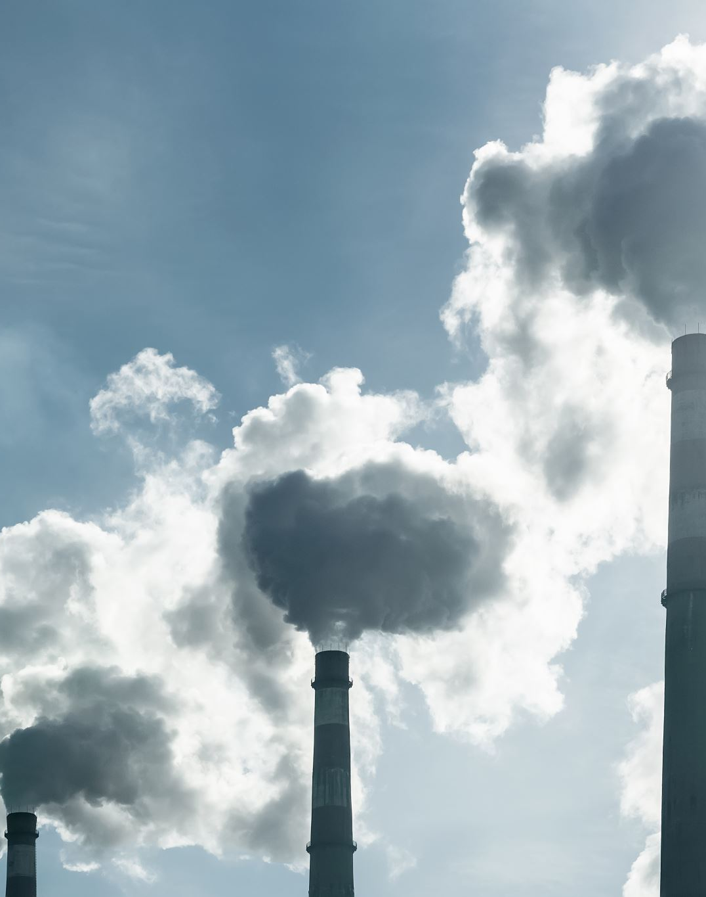
CO₂ Emissions
Group 6
Team Members:
Mohammed Hamdouna
Myrna Deseo
Rasika Senadheera

Slide 2
What is CO₂ emission
Carbon dioxide emissions are those stemming from the burning of fossil fuels and the manufacture of cement. They include carbon dioxide produced during consumption of solid, liquid, and gas fuels and gas flaring.

Slide 3
Why is increasing CO₂ emission a concern?
Carbon dioxide is an important greenhouse gas that can maintain the global surface temperature above freezing.
HOWEVER, increasing CO₂ in the environment increases the natural greenhouse effect that causes global temperatures to increase.
Consequence is: GLOBAL WARMING!

Slide 4
Top sources for CO₂ emissions
Emissions of CO₂ arise from a number of sources:
Fossil fuel combustion in the power generation
Industrial
Residential
Transportation

Slide 5
This Project
Date Source:
https://www.kaggle.com/datasets/thedevastator/global-fossil-co2-emissions-by-country-2002-2022
Objectives:
1. Visualisations of the CO₂ emission by country.
2. Determine the top 15 countries that has highest CO₂ emission.
3. Track a country’s progress in reducing CO₂ emissions.
4. Determine models that best predict the target parameter (total CO₂ emissions) with an accuracy of greater than 75%.
\

Slide 6
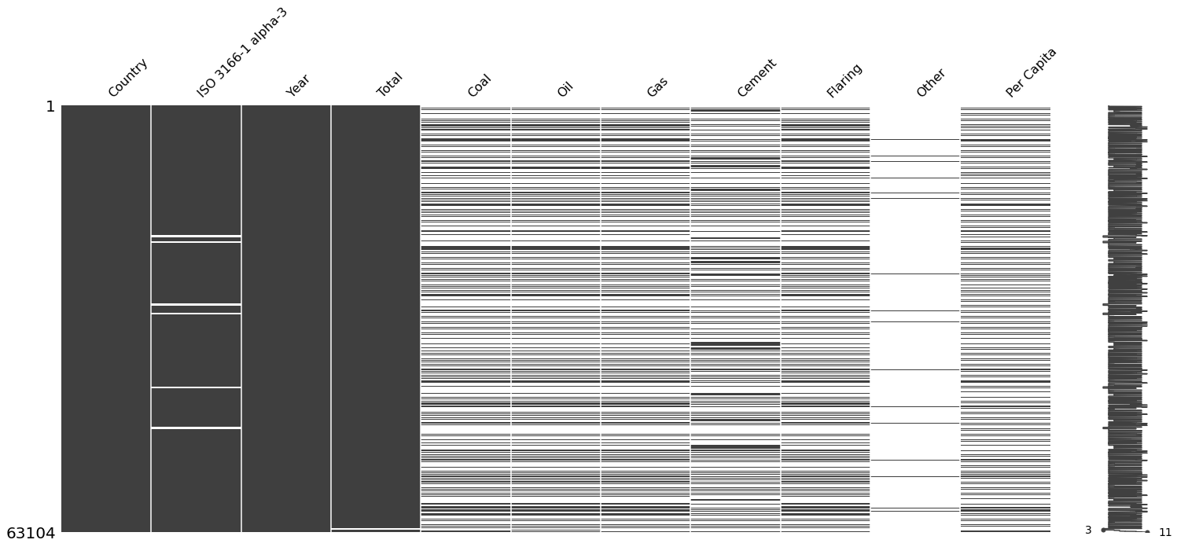
Data Cleanup
Check dataset for missing values using a visual matrix
Syntax: import missingno as msno
msno.matrix(emissions_data)
No Data
Notes:
It is helpful to visualise the dataset matrix in determining the extent of null values within the data set.
To do this, using ‘missing number’ is better.
Missing number is a Python library that can create a matrix that shows the presence and distribution of missing data within a Pandas dataframe.
The white gaps within columns indicate missing values
The column “Other” clearly shows the sparsity of data in that column and thus was excluded and deleted.

Slide 7
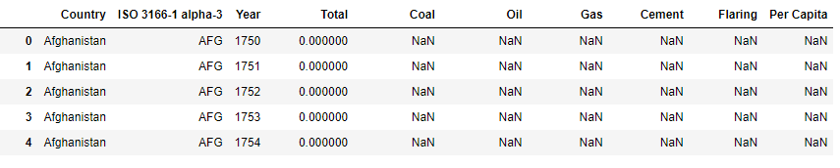
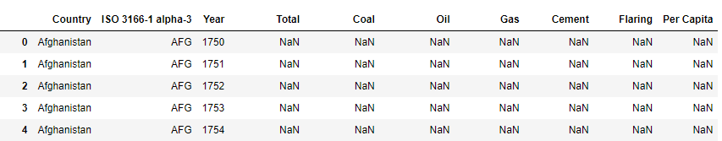
Data Cleanup
Syntax: emissions_data = emissions_data.replace(0, np.nan)
Syntax: cleaned_emissions_df = emissions_data.dropna(how=“any”)
Notes:
Further look into the dataset showed that the dataframe has cells with “0” values. Using “dropna” will not delete cells with “0’ values since it recognises “0” as a value.
To delete cell with “0” values, the “0” values were first replaced with “NaN” and then all cells with “NaN” were dropped.

Slide 8
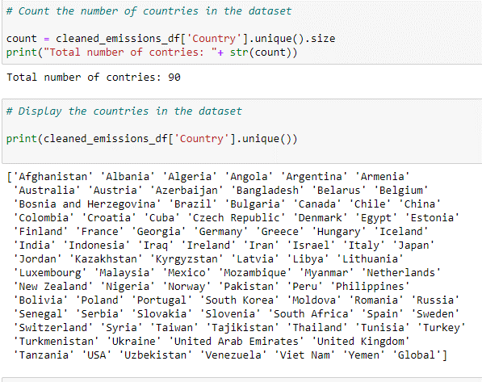
Determine number of countries
Notes:
Dataframe has 90 countries and as listed above and saved as a new file for analysis

Slide 9
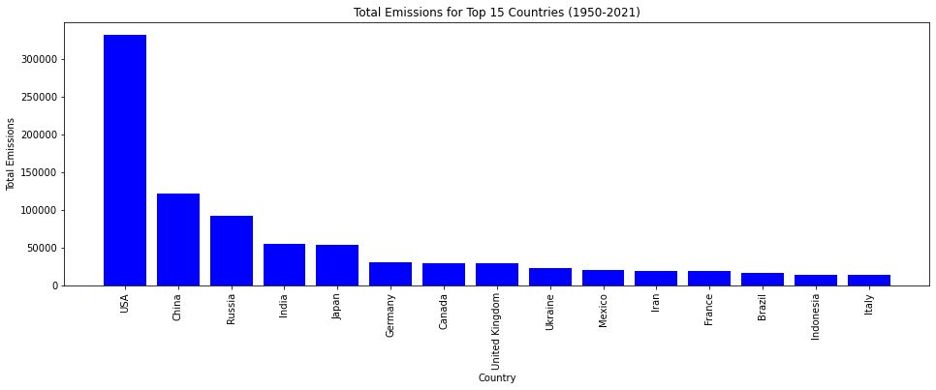
Visualisations
Total Emissions for Top 15 Countries excluding Global Data (1950 – 2021)
Notes:
A simple bar plot using Matplotlib showing the total emissions for top 15 countries excluding global

Slide 10
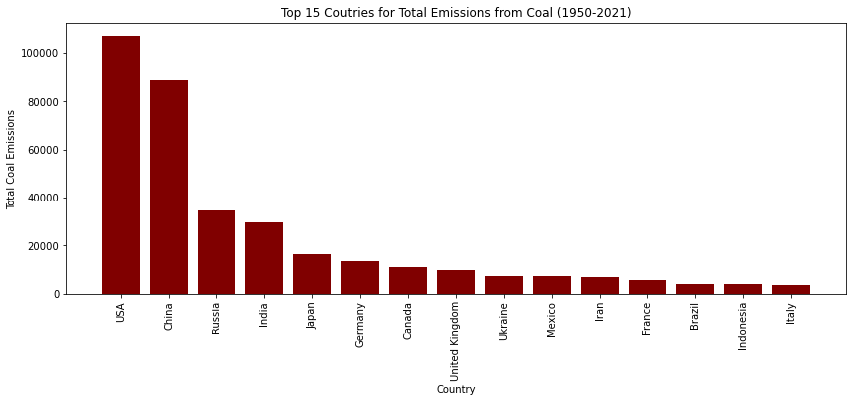
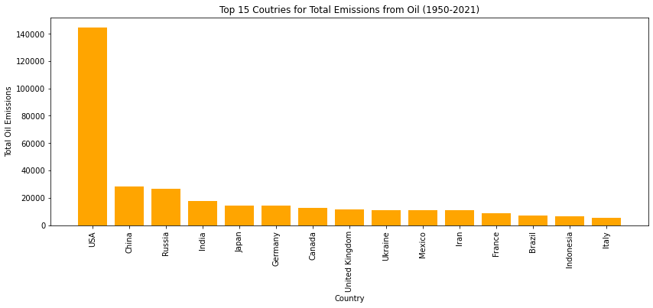
Top 15 Countries Emissions Per Source
COAL
OIL
Notes:
These plots show the trend for the top 15 countries for CO₂ emissions from different sources
The USA still shows the highest CO₂ emissions from all sources

Slide 11
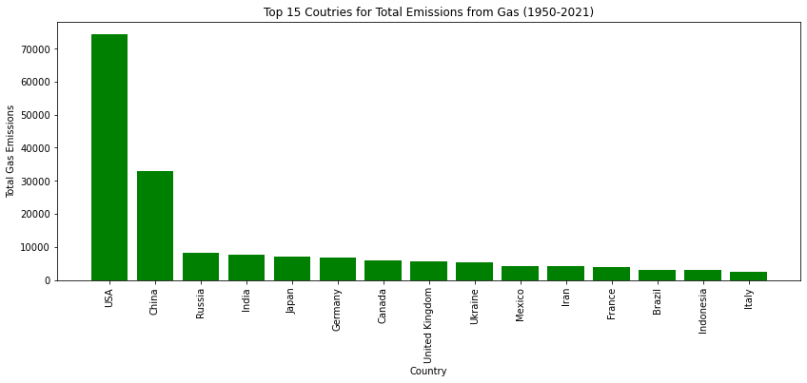
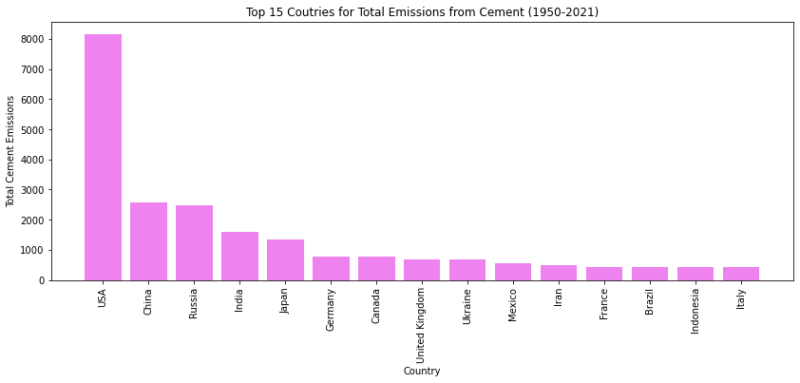
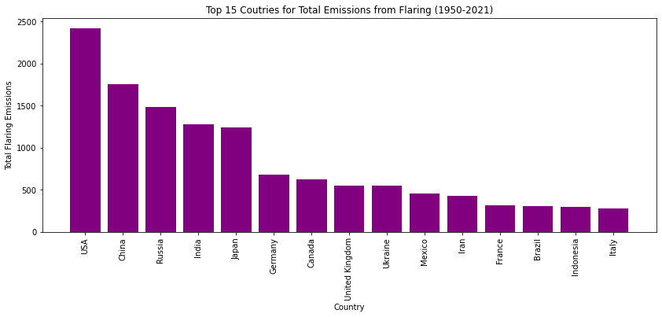
Top 15 Countries Emissions Per Source
GAS
FLARING
CEMENT
Notes:
These plots show the trend for the top 15 countries for CO₂ emissions from different sources
The USA still shows the highest CO₂ emissions from all sources

Slide 12
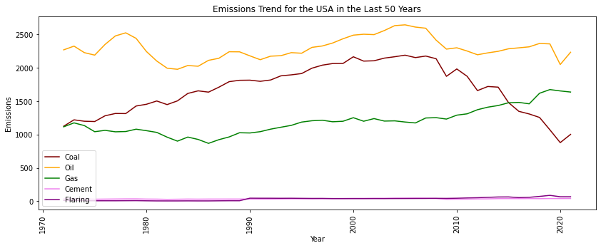
Emissions Trend for USA in the Last 50 Years
Notes:
An overlaid line plot using Matplotlib showing the different sources of carbon dioxide emissions for the USA in the last 50 years

Slide 13
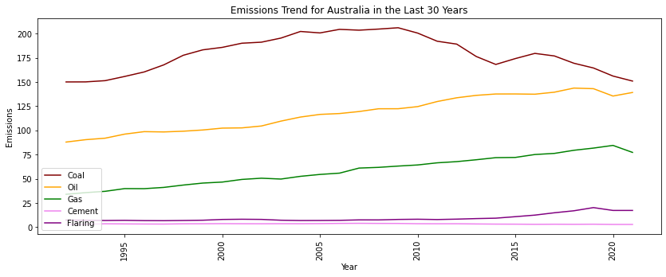
Emissions Trend for Australia from Each Source

Slide 14
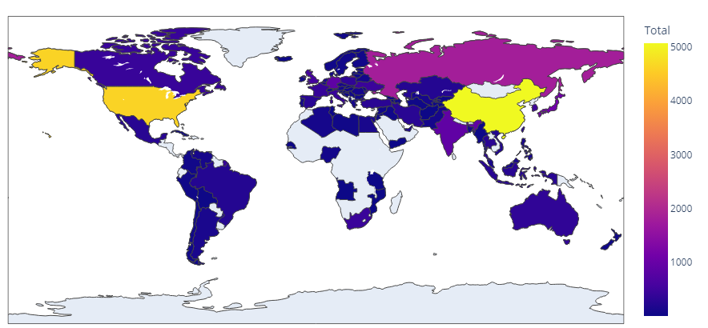
Chloropleth Map
Map of the mean total emissions for each country (excluding global data)

Slide 15
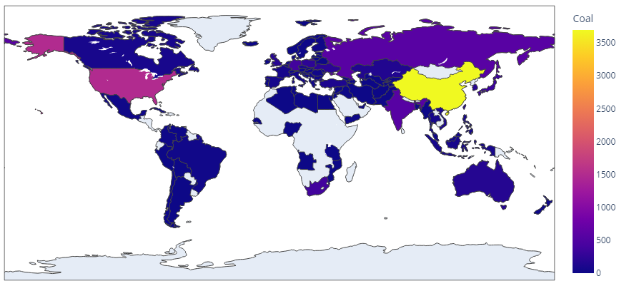
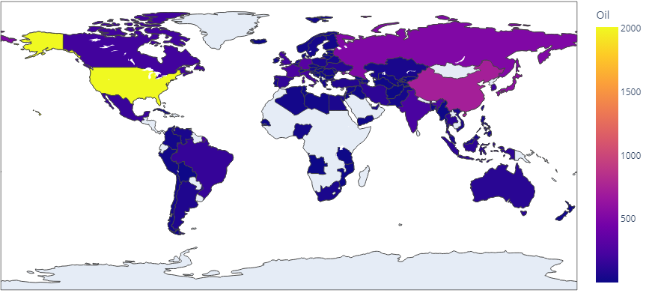
Chloropleth Map
Map of the mean emissions by source for each country (excluding global data)
COAL
GAS

Slide 16
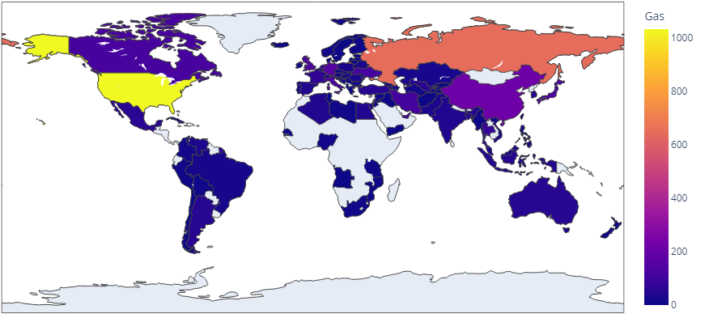
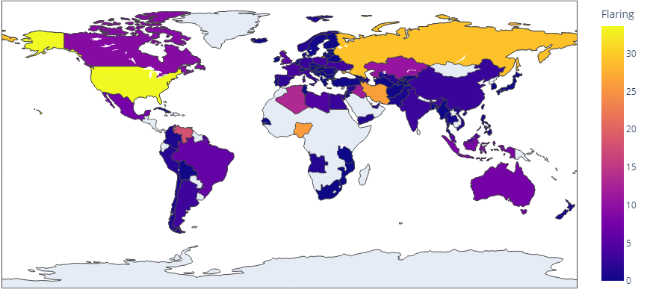
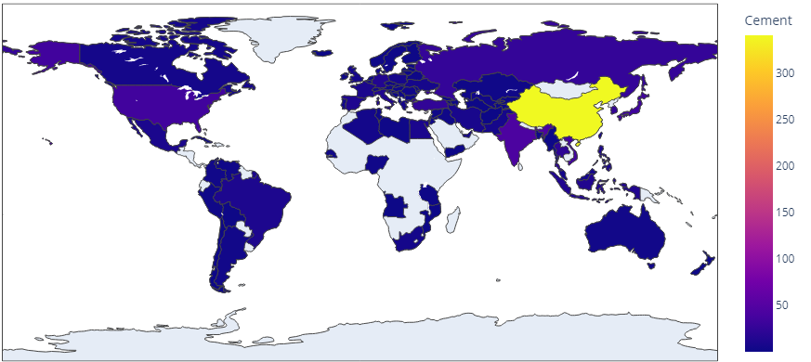
Chloropleth Map
Map of the mean emissions by source for each country (excluding global data)
OIL
FLARING
CEMENT

Slide 17

Which Machine Learning Model
Things to consider before choosing model:
Classification or Regression? (Supervised Learning)
Clustering or Dimensionality Reduction? (Unsupervised Learning)
Reinforcement Learning?

Slide 18


Which Machine Learning Model
Based on CO₂ Emission Dataset, we concluded the following:
Classification
Regression
Clustering
Dimensionality Reduction
Reinforcement Learning

Slide 19
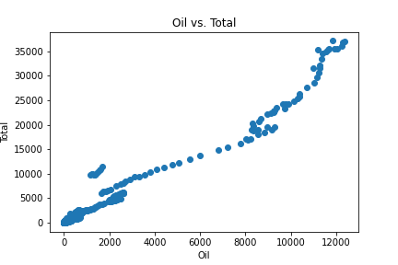
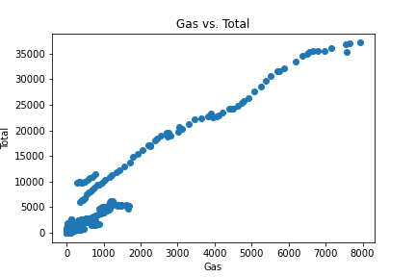
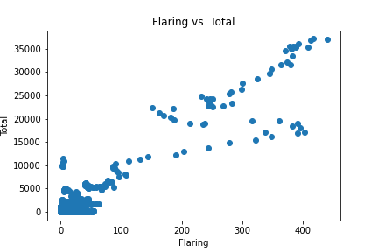
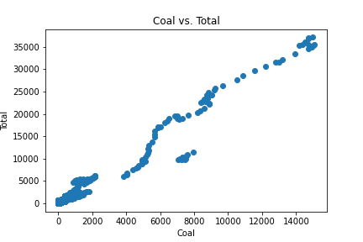
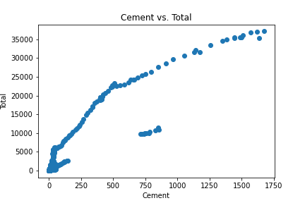
Factors Affecting CO₂ Emissions

Slide 20
Regression Models
Linear Regression
Training Score: 99.99 %
Testing Score: 99.99 %
Lasso Regression
Training Score: 99.99 %
Testing Score: 99.99 %
Ridge Model
Training Score: 99.99 %
Testing Score: 99.99 %
Elastic Net Model
Training Score: 98.48 %
Testing Score: 98.89 %
Using train_test_split from sklearn

Slide 21
Regression Models
Linear Regression
Training Score: 99.99 %
Testing Score: 99.99 %
Lasso Regression
Training Score: 99.99 %
Testing Score: 99.99 %
Ridge Model
Training Score: 99.99 %
Testing Score: 99.99 %
Elastic Net Model
Training Score: 97.17 %
Testing Score: 99.37 %
Using manual split with .loc[] with 70% training data and 30% testing data.

Slide 22
Conclusion
The top 15 CO₂ producing countries are consistent through the five main sources (coal, oil, gas, cement, flaring).
Clear downward trend in CO₂ emission from coal were observed in both the USA and Australia.
Four models were used (linear, lasso, ridge and elastic net) to best predict the total CO₂ emissions.
All four models showed an accuracy of greater than 95%.

Slide 23
Thank you for your attention.
QUESTIONS?

